Slide 1
Chapter 3
3-4 ~ 3-5

Slide 2
Subtyping and Inheritance in C++
Inheritance is used to express subtype relationships between two ADTs.
If B inherits from A, then B IS-A A. Also, A is more general than B.
  VW Beetle IS-A Car
  Eagle IS-A Bird
C++ provides a mechanism to express the IS-A relationship called public inheritance .
  class Stack : public Bag -- Stack publicly inherits from Bag , Bag is called base class , and Stack is called derived class

Slide 3
Inheritance
A derived class inherits all the non-private members (data and functions) of the base class.
Inherited members from public inheritance have the same level of access in the derived class as they did in the base class.
C++ allow us to reuse the base-class implementation of an operation in a derived class ; and it is also possible to override the base-class implementation ( using the keyword virtual ) .

Slide 4
Class Inheritance Example
class Bag
{
public:
Bag( int MaxSize = DefaultSize ); // constructor
virtual ~Bag( ); // destructor
virtual void Add( int ); // insert element into bag
virtual int* Delete( int& ); // delete element from bag
virtual Boolean IsFull( ); // return TRUE if the bag is full; FALSE otherwise
virtual Boolean IsEmpty( ); // return TRUE if the bag is empty; FALSE otherwise
protected:
virtual void Full( ); // action when bag is full

Slide 5
Class Inheritance Example (cont.)
virtual void Empty(); // action when bag is empty
int *array;
int MaxSize; // size of array
int top; // highest position in array that contains an element
} ;
class Stack : public Bag
{
public:
Stack( int MaxSize = DefaultSize ) ; // constructor
~Stack( ); // destructor
int* Delete( int& ); // delete element from stack
};

Slide 6
Class Inheritance Example (cont.)
Stack :: Stack ( int MaxStackSize ) : Bag( MaxStackSize ) { }
// Constructor for Stack calls constructor for Bag
Stack :: ~Stack( ) { }
// Destructor for Bag is automatically called when Stack
// is destroyed. This ensures that array is deleted.
int* Stack :: Delete( int& x )
{
if ( IsEmpty( ) ) { Empty( ) ; return 0 ; }
x = array[ top-- ] ;
return &x ;
}

Slide 7
Class Inheritance Example (Cont.)
Bag b(3); // uses Bag constructor to create array of size 3
Stack s(3); // uses Stack constructor to create array of size 3
b.Add(1) ; b.Add(2) ; b.Add(3) ;
// use Bag::Add . It calls functions Bag::IsFull and Bag::Full
s.Add(1) ; s.Add(2) ; s.Add(3) ;
// Stack::Add not defined , so use Bag::Add . Bag::Add calls Bag::IsFull
// and Bag::Full because these have not been redefined in Stack
int x ;
b.Delete(x) ; // uses Bag::Delete, which calls Bag::IsEmpty and Bag::Emtpy
s.Delete(x) ;
// uses Stack::Delete, which calls Bag::IsEmtpy and Bag::Emtpy because these
// have not been redefined in Stack.

Slide 8
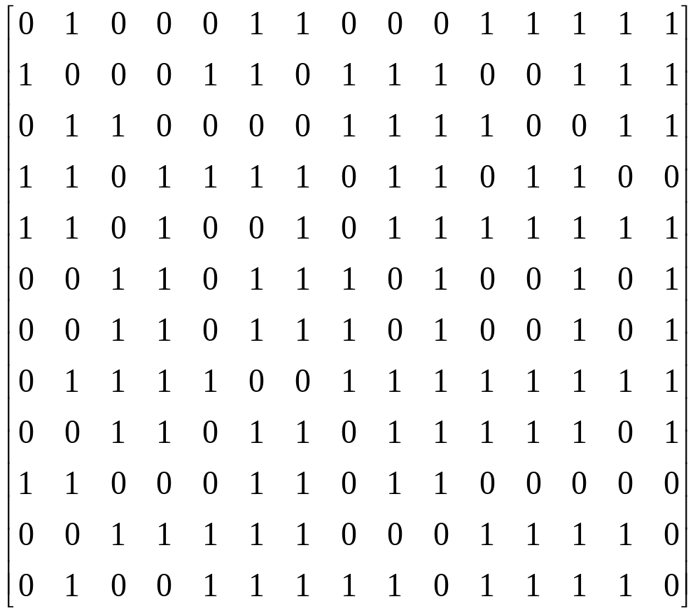
A Mazing Problem
Entrance
Exit
An Example maze ( can you find a path ? )

Slide 9
A Mazing Problem (cont.)
Represent the maze by two dimensional array , maze [i][j] , where 1 <= i <= m and 1 <= j <= n
A value of 1 implies a blocked path , and a 0 means one can walk on through .
Assume the rat starts at maze[1][1] , and the exit is at maze[m][p] . ( maze[1][1]=maze[m][p]=1 )
The location of the rat in the maze can at any time be described by the row , i , and column , j , of its position .

Slide 10
Allowable Moves
N
If all the surrounding
squares have a 0 ,
then the rat can
choose any of these
eight squares as its
next position .
We must careful because
not every position has
eight neighbors . So we
declare maze[m+2][p+2],
[i-1][j-1]
[i-1][j]
[i-1][j+1]
NW
NE
W
[i][j-1]
X
[i][j+1]
E
[i][j]
[i+1][j-1]
[i+1][j]
[i+1][j+1]
SW
S
SE
( maze[0][j] , maze[m+1][j], maze[i][0] , maze[i][p+1] is the wall ,
and set them are 1 , where 0 <= j <=p+1 , 0 <= i <= m+1 )

Slide 11
Allowable Moves
struct offsets
{ q move[q].a move[q].b
int a, b;
}; N -1 0
NE -1 1
enum directions { E 0 1
N , NE , E , SE , S , SW , W , NW } ; SE 1 1
offsets move[8] ; S 1 0
SW 1 -1
W 0 -1
NW -1 -1
If we are at position [i][j] in the maze
and we wish to find the position [g][h] that is southwest of us , then
we set g = i + move[SW].a ; h = j + move[SW].b ;

Slide 12
A Mazing Problem (cont.)
As we move through the maze , we may have the chance to go in several directions . ( which one be chosen ? )
We pick one but save our current position and the direction of the last move in a list .
  If we taken a false path , we can return and try another direction .

Slide 13
A Mazing Problem (Cont.)
Stack is used in solving the maze problem for storing the coordinates and direction.
In order to prevent us from going down the same path twice , we use another array mark[m+2][p+2] , which initially zero . mark[i][j] is set to 1 once we arrive at that position .

Slide 14
First pass at finding a path through a maze
initialize stack to the maze entrance coordinates and direction east ;
While ( stack is not empty)
{
( i , j , dir ) = coordinates and direction deleted from top of
stack ;
while ( there are more moves)
{
( g , h ) = coordinates of next move ;
if ( ( g==m ) && ( h==p ) )
success ;

Slide 15
First pass at finding a path through a maze (cont.)
if ( ( !maze[g][h] ) && ( !mark[g][h] ) )
{
mark[g][h] = 1 ;
dir = next direction to try ;
add ( i , j , dir ) to top of stack ;
i = g ; j = h ; dir = north ;
}
}
}
cout << “ no path found ” << endl ;

Slide 16
Implementation of finding a path through a maze
struct items {
int x , y , dir ;
} ;
void path ( int m , int p )
// Output a path ( if any ) in the maze ; maze[0][i] = maze[m+1][i] =
// maze[j][0] = maze[j][p+1] = 1 , 0 <= i <= p+1 , 0 <= j <= m+1
{
// start at ( 1 , 1 )
mark[1][1] = 1 ;
Stack<items> stack( m*p ) ;
items temp ;
temp.x = 1 ; temp.y = 1 ; temp.dir = E ;
stack.Add( temp ) ;

Slide 17
Implementation of finding a path through a maze
while( !stack.IsEmpty() ) // stack not empty
{
temp = *stack.Delete( temp ) ; // unstack
int i = temp.x ; int j = temp.y ; int d = temp.dir ;
while( d<8 ) // move forward
{
int g = i + move[d].a ; int h = j + move[d].b ;
if( ( g==m ) && ( h==p ) ) { // reached exit
// output path
cout << stack ;
cout << i << “ ” << j << endl ; // last two squares on the path
cout << m << “ “ << p << endl ;
return ;
}

Slide 18
Implementation of finding a path through a maze
if( ( !maze[g][h] ) && ( !mark[g][h])) { // new position
mark[g][h] = 1 ;
temp.x = i ; temp.y = j ; temp.dir = d+1 ;
stack.Add( temp ) ; // stack it
i = g ; j = h ; d = N ; // move to ( g, h )
}
else d++ ; // try next direction
}
}
cout << “ no path in maze ” << endl ;
}

Slide 19
Implementation of finding a path through a maze
template <class KeyType>
ostream& operator<<( ostream& os , Stack<KeyType>& s )
{
os << “ top= ” << s.top << endl ;
for( int i = 0 ; i <= s.top ; i++ )
os << i << “:” << s.stack[i] << endl ;
return os ;
}
ostream& operator<<( ostream& os , items& item )
{
return os << item.x << “,” << item.y << “,” << item.dir ;
}

